Slide 1



Preeti verma Emad Soheili Anthony Defor Mahdi Abouei
Vehicle Insurance Cross-Sell Prediction
Feb 8th, 2023

Slide 2
Agenda
Motivation
Predictive Modelling
Business Insights and Recommendation
Descriptive Analysis

Slide 3
Motivation

Slide 4

Overview
Top Insurer, a Toronto-based insurance company is growing rapidly in terms of selling new insurance products. The majority of Top Insurer’s customer base are subscribers of the Health Insurance policy it has been offering over the past years.
This year, Top Insurer has introduced a new Vehicle Insurance and is keen on exploring ways to decipher if its policyholders (customers) would be interested in purchasing this new insurance policy.
A recent market survey has shown a healthy conversion rate of over 22% on selling new insurance policies to existing policyholders. Motivated by this, Top Insurer seeks for more nuanced analysis to be used as a basis for their marketing and sales strategies on the new Vehicle Insurance.

Slide 5
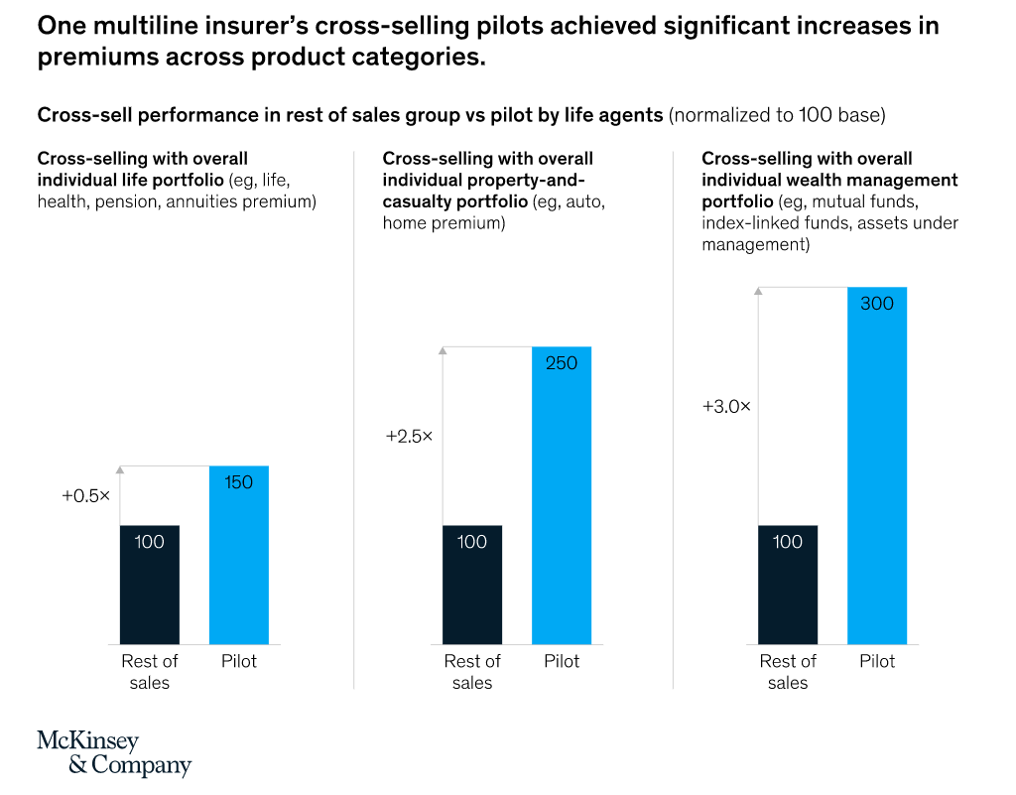
Cross-Selling
A Customer Relationship Management tool that allows for increasing the number of products of a company’s existing customers¹.
Lowers costs of marketing and sales;
Higher response rates;
Lowers customer churn rate;

Slide 6


Cross-Selling
Develop a Predictive Model That Allows Top Insurer to Cross-sell Its New Vehicle Insurance with High Accuracy

Slide 7
Descriptive Analysis

Slide 8

Data Set
Variable/Feature | Definition
id | Unique ID for the customer
Gender | Gender of the customer
Age | Age of the customer
Driving_License | 0 : Customer does not have DL, 1 : Customer already has DL
Region_Code | Unique code for the region of the customer
Previously_Insured | 1 : Customer already has Vehicle Insurance, 0 : Customer doesn't have Vehicle Insurance
Vehicle_Age | Age of the Vehicle
Vehicle_Damage | 1 : Customer got his/her vehicle damaged in the past. 0 : Customer didn't get his/her vehicle damaged in the past.
Annual_Premium | The amount customer needs to pay as premium in the year
Policy_Sales_Channel | Anonymized Code for the channel of outreaching to the customer ie. Different Agents, Over Mail, Over Phone, In Person, etc.
Vintage | Number of Days, Customer has been associated with the company
Response | 1 : Customer is interested, 0 : Customer is not interested
“Health Insurance Cross Sell Prediction” From Kaggle.com

Slide 9
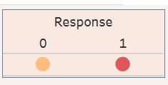
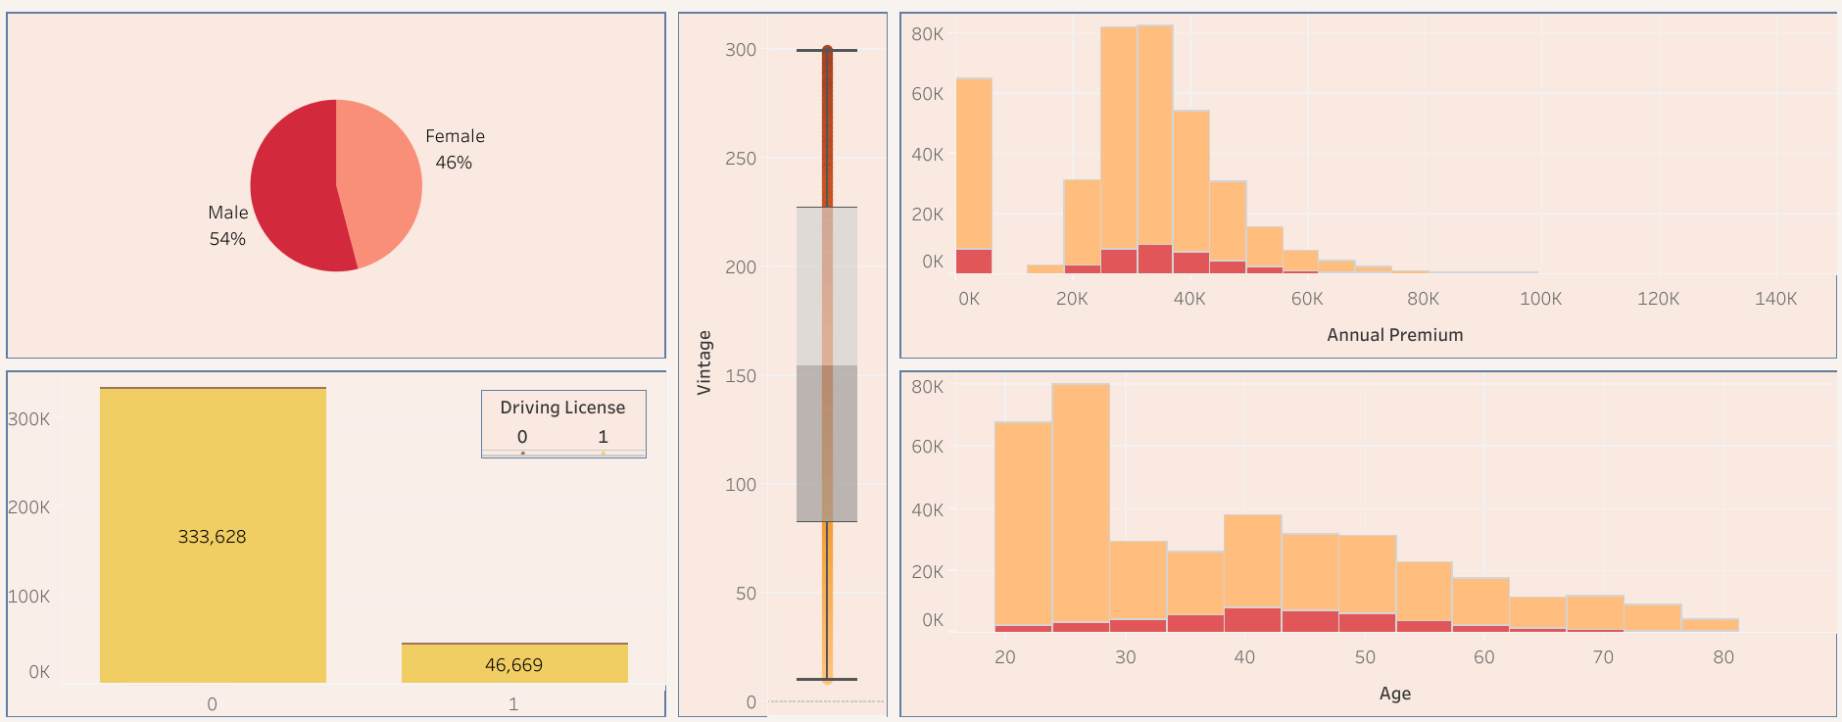
Feature Characteristics

Slide 10
Predictive Modelling

Slide 11
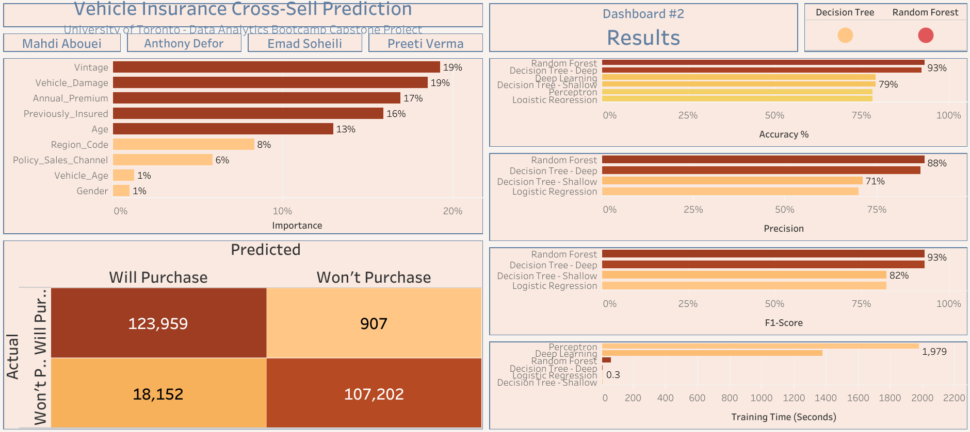
Model Evaluation
100
78
Prediction Accuracy
14
0
By Chance
Logit
Neural Net
Decision Tree
Random Forest

Slide 12
Business Insights And Recommendation

Slide 13

Feature Importance

Slide 14
Recommendations
Additional analysis can be used to improve customer targeting:
Incorporate the results with customer segmentation analysis;
Visualize unstandardized decision tree to develop specific decision rules;
Join with new data sources:
Explain broader variance in selected features
Expand the cross-selling basket

Slide 15
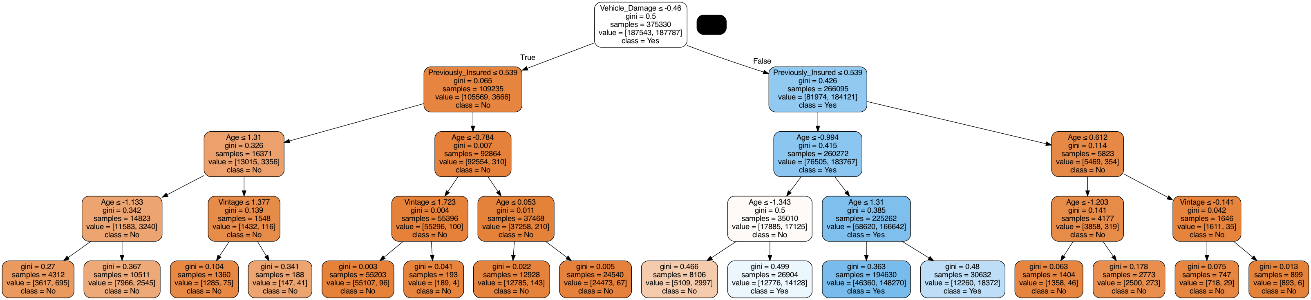
Decision Tree Visualization

Slide 16
Any Questions?
Thank you!

Slide 17
References
Kamakura, W. A., Wedel, M., De Rosa, F., & Mazzon, J. A. (2003). Cross-selling through database marketing: A mixed data factor analyzer for data augmentation and prediction. International Journal of Research in marketing, 20(1), 45-65.
Thuring, F. (2012). A credibility method for profitable cross-selling of insurance products. Annals of Actuarial Science, 6(1), 65-75.
https://www.mckinsey.com/industries/financial-services/our-insights/unlocking-the-potential-of-deeper-customer-agent-insurer-relationships

Slide 18
Appendix

Slide 19

Links to Dashboards
Exploratory Data Analysis
Predictive Models Results

Slide 20
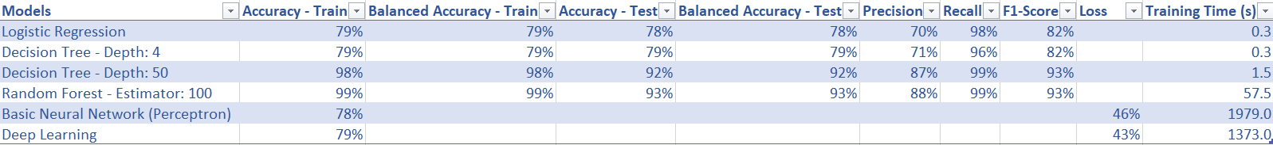
Model Comparison Table

